Slide 1

AJAX and jQuery AJAX
AJAX Concepts, XMLHttpRequest, jQuery AJAX
SoftUni Team
Technical Trainers
Software University
http://softuni.bg

Slide 2
Table of Contents
AJAX Concepts
XMLHttpRequest
jQuery AJAX
$.load
$.get() / $.post()
$.ajax()
AJAX - Examples
Accessing Firebase with AJAX

Slide 3
Have a Question?
sli.do #JS-CORE

Slide 4

AJAX
Asynchronous JavaScript аnd XML

Slide 5
What is AJAX?
Asynchronous JavaScript And XML
Background loading of dynamic content/data
Load data from the Web server and render it
Two types of AJAX
Partial page rendering
Load HTML fragment + show it in a <div>
JSON service
Load JSON object and display it with JS/jQuery

Slide 6




AJAX: Workflow
1. HTTP request (initial page load)
2. HTTP response (HTML page)
AJAX request
UI Interaction
AJAX response (asynchronous)
AJAX handler
Web Client
Returns data as JSON / HTML
Web Server
Modify the page DOM

Slide 7
AJAX request
AJAX response
Web Client
Web Server
Using the XMLHttpRequest Object

Slide 8
XMLHttpRequest - Standard API for AJAX
<button onclick="loadRepos()">Load Repos</button>
<div id="res"></div>
function loadRepos() {
let req = new XMLHttpRequest();
req.onreadystatechange = function() {
if (this.readyState == 4 && this.status == 200)
document.getElementById("res").textContent =
this.responseText;
};
req.open("GET",
"https://api.github.com/users/testnakov/repos", true);
req.send();
}
Check your code here: https://judge.softuni.bg/Contests/1568/Lab-AJAX

Slide 9
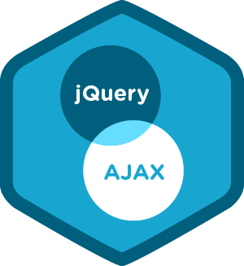
jQuery AJAX
Simplified AJAX Calls with jQuery

Slide 10
jQuery AJAX
Simplifies AJAX calls
Load any static/dynamic data
Pass data to the server using data parameter
jQuery methods can be called during the life cycle of AJAX call progress
ajaxSuccess (callback) - callback for whenever an AJAX request completes successfully
ajaxStop(callback) - callback for whenever all AJAX requests have ended

Slide 11
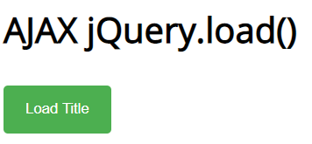
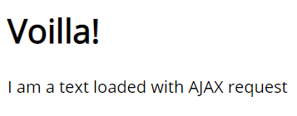
Problem: AJAX Load
Create a page holding a button. Clicking the button should load a html fragment and display it inside a div.

Slide 12
Solution: AJAX Load
ajax-load.html
<div id="text">
<h1>AJAX jQuery.load()</h1>
<button onclick="loadTitle()">Load Title</button>
</div>
ajax-load.js
text.html
function loadTitle() {
$('#text').load("text.html");
}
<h1>Voilla!</h1>
<p>I am a text loaded with AJAX request</p>
Check your solution here: https://judge.softuni.bg/Contests/1568/Lab-AJAX

Slide 13
Handling Errors
Scripts can execute AJAX requests
To their origin (same-origin policy)
When the remote server explicitly allows AJAX calls via CORS
Uses a special HTTP header: Access-Control-Allow-Origin
$(document).ajaxError(function(event, req, settings) {
$('#text').text(`Error loading data: ${req.status} (${req.statusText})`);
});
function loadTitle() {
$('#text').load("http://dir.bg");
}
This cross-origin AJAX request will fail due to missing CORS headers

Slide 14
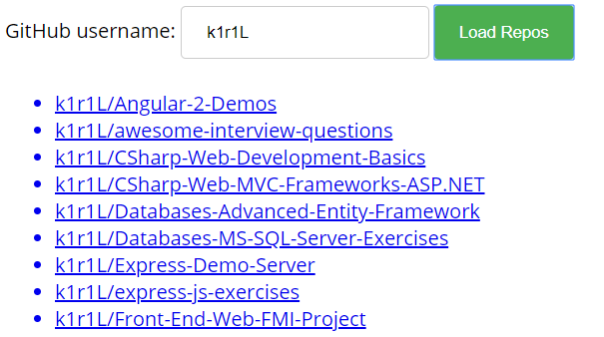
Problem: Load GitHub Repos with AJAX
GitHub username:
<input type="text" id="username" value="k1r1L" />
<button onclick="loadRepos()">Load Repos</button>
<ul id="repos"></ul>
function loadRepos() {
// AJAX call …
}

Slide 15
Solution: Load GitHub Repos with AJAX
function loadRepos() {
$("#repos").empty();
let url = "https://api.github.com/users/" +
$("#username").val() + "/repos";
$.ajax({ url,
success: displayRepos,
error: displayError
});
function displayRepos(respos) { … }
function displayError(err) { … }
}

Slide 16
Solution: Load GitHub Repos with AJAX (2)
function displayRepos(respos) {
for (let repo of respos) {
let link = $('<a>').text(repo.full_name);
link.attr('href', repo.html_url);
$("#repos").append($('<li>').append(link));
}
}
function displayError(err) {
$("#repos").append($("<li>Error</li>"));
}
Check your solution here: https://judge.softuni.bg/Contests/1568/Lab-AJAX

Slide 17

AJAX - Examples
Using jQuery to Access REST APIs

Slide 18
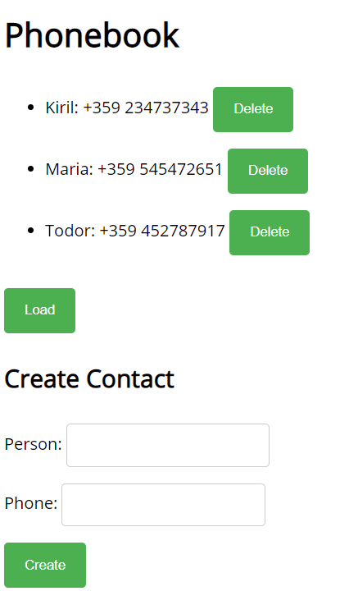
Problem: Phonebook App in Firebase
Create a mini phonebook app that hold your data in Firebase. Disable the authentication to simplify your work. Implement "list phones", "add phone", "delete phone“.

Slide 19
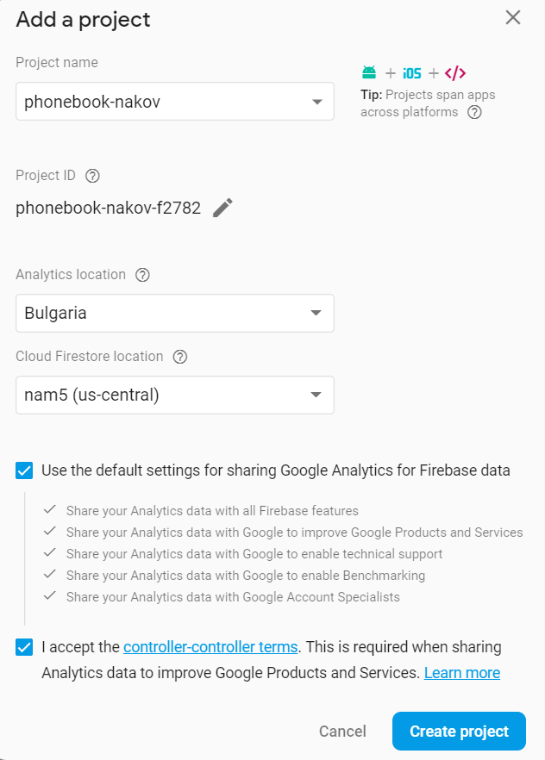
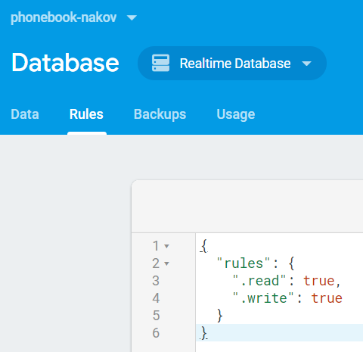
Solution: Setup a Firebase DB
Create a new project at Firebase and enable public read/write access

Slide 20
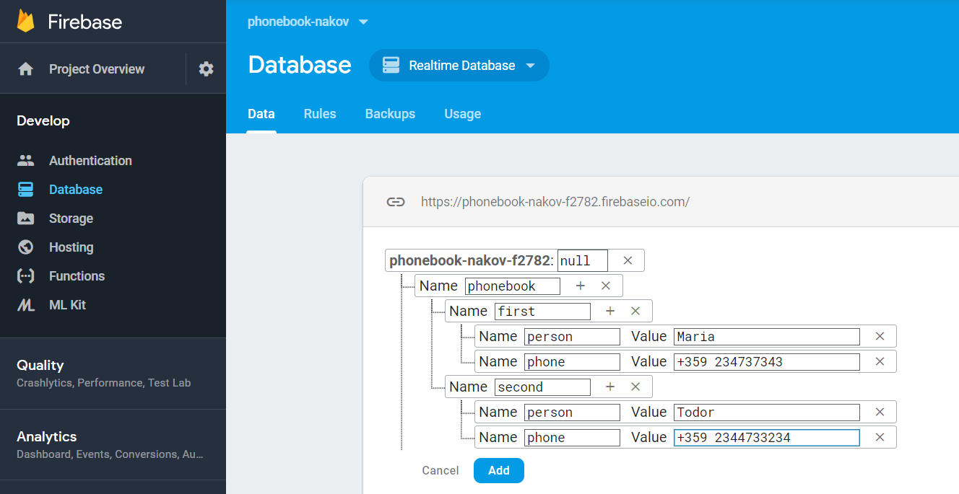
Solution: Add Sample Data in Firebase

Slide 21
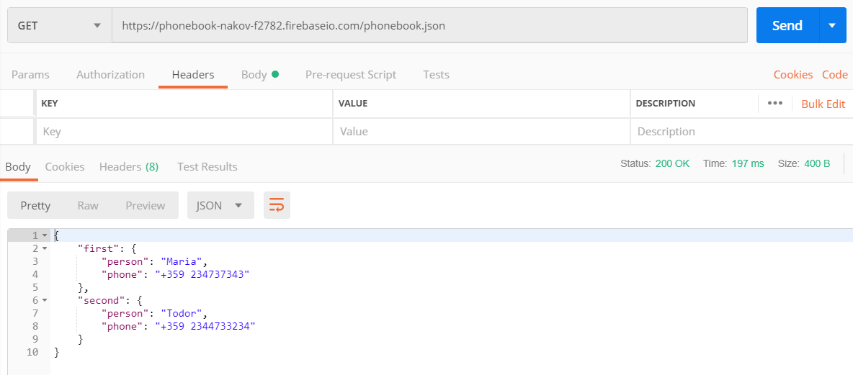
Solution: Test Your REST Service

Slide 22
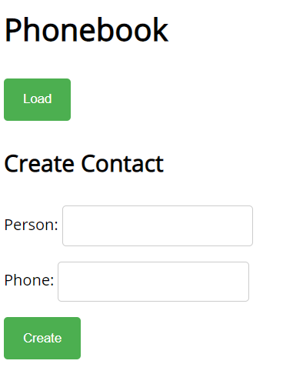
Solution: Phonebook in Firebase - HTML
<h1>Phonebook</h1>
<ul id="phonebook"></ul>
<button id="btnLoad">Load</button>
<h2>Create Contact</h2>
Person: <input type="text" id="person" />
<br>
Phone: <input type="text" id="phone" />
<br>
<button id="btnCreate">Create</button>

Slide 23
Solution: Phonebook in Firebase - JS Code
$(function () {
$('#btnLoad').click(loadContacts);
$('#btnCreate').click(createContact);
let baseServiceUrl =
'https://phonebook-nakov.firebaseio.com/phonebook';
function loadContacts() { … }
function displayContacts(contacts) { … }
function displayError(err) { … }
function createContact() { … }
function deleteContact(key) { … }
});

Slide 24
Solution: Phonebook in Firebase - JS Code
function loadContacts() {
$("#phonebook").empty();
$.get(baseServiceUrl + '.json')
.then(displayContacts)
.catch(displayError);
}
function displayError(err) {
$("#phonebook").append($("<li>Error</li>"));
}

Slide 25
Solution: Phonebook in Firebase - JS Code
function displayContacts(contacts) {
for (let key in contacts) {
let person = contacts[key]['person'];
let phone = contacts[key]['phone'];
let li = $("<li>");
li.text(person + ': ' + phone + ' ');
$("#phonebook").append(li);
li.append($("<button>Delete</button>")
.click(deleteContact.bind(this, key)));
}
}
Bind the event handler with the current key

Slide 26
Solution: Phonebook in Firebase - JS Code
function createContact() {
let newContactJSON = JSON.stringify({
person: $('#person').val(),
phone: $('#phone').val()
});
$.post(baseServiceUrl + '.json', newContactJSON)
.then(loadContacts)
.catch(displayError);
$('#person').val('');
$('#phone').val('');
}

Slide 27
Solution: Phonebook in Firebase - JS Code
function deleteContact(key) {
let request = {
method: 'DELETE',
url: baseServiceUrl + '/' + key + '.json'
};
$.ajax(request)
.then(loadContacts)
.catch(displayError);
}
The correct contact key will come as parameter (due to binding)
Check your solution here: https://judge.softuni.bg/Contests/1568/Lab-AJAX

Slide 28


Practice: jQuery AJAX
Live Exercises in Class (Lab)

Slide 29

Summary
Arrow functions ≈ short function syntax
AJAX == Asynchronous JavaScript and XML
AJAX sends asynchronous HTTP requests
Scripts can execute AJAX requests
jQuery simplifies AJAX calls
The $.ajax() function underlies all AJAX requests sent by jQuery

Slide 30
https://softuni.bg/courses/js-apps

Slide 31













SoftUni Diamond Partners

Slide 32




SoftUni Organizational Partners

Slide 33




Trainings @ Software University (SoftUni)
Software University - High-Quality Education and Employment Opportunities
softuni.bg
Software University Foundation
http://softuni.foundation/
Software University @ Facebook
facebook.com/SoftwareUniversity
Software University Forums
forum.softuni.bg

Slide 34

License
This course (slides, examples, demos, videos, homework, etc.) is licensed under the "Creative Commons Attribution-NonCommercial-ShareAlike 4.0 International" license

